Slide 1
Format String Vulnerabilities
ENPM 691

Slide 2
References
Hacking – The art of exploitation
Chapter 3 on Buffer Overflows
Chapter 5 on Shellcode
Secure Coding in C and C++
Chapter 6
http://crypto.stanford.edu/cs155old/cs155-spring08/papers/formatstring-1.2.pdf

Slide 3
Agenda for today
Format String – A Quick Overview
Format String Vulnerabilities
Crashing a program
Reading from stack
Writing to arbitrary memory location
Global Offset Table (GOT) corruption
Running a shellcode
Hands on demo

Slide 4
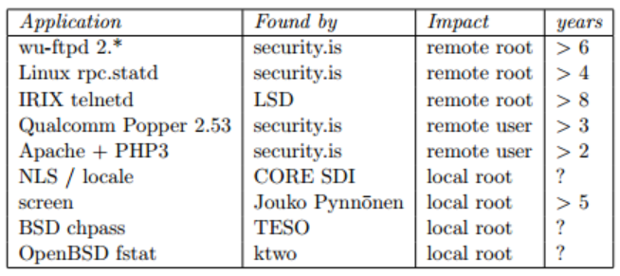
Format String Vulnerabilities

Slide 5
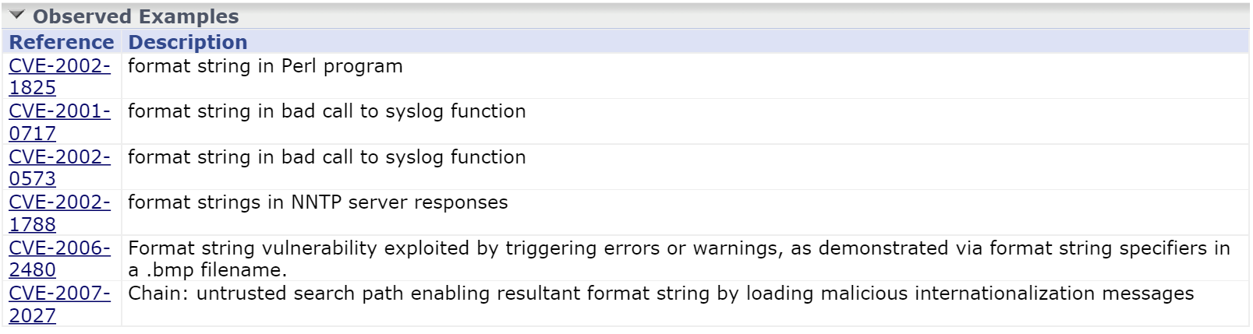
Some CVEs

Slide 6
Format Function - Examples
Sample format function
# of Args in the format string
printf(“%d”, x);
printf(“%d %d”, x, y);
printf(“%s”);
printf(“%s%s”);
1
2
1
2
Functions such as printf, fprintf are called Variadic
They accept variable number of arguments

Slide 7
Some family of format functions
fprintf — prints to a FILE stream
printf — prints to the ‘stdout’ stream
sprintf — prints into a string
snprintf — prints into a string with length checking

Slide 8
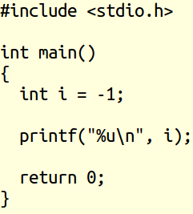
Basic examples of printf
%u converted -1 into unsigned int

Slide 9
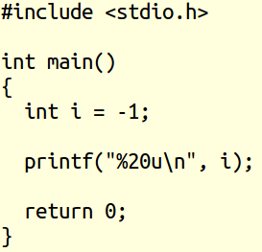
Basic examples of printf
%20u created 10 spaces in front – 20 alignment

Slide 10
Use of format functions
allow to convert simple C data types to a string representation
allow to specify the format of the representation
process the resulting string (output to stderr, stdout, syslog, ...)

Slide 11
How format functions work?
the format string controls the behavior of the function
it speciﬁes the type of parameters that should be printed
parameters are saved on the stack (pushed)
saved either directly (by value), or indirectly (by reference)

Slide 12
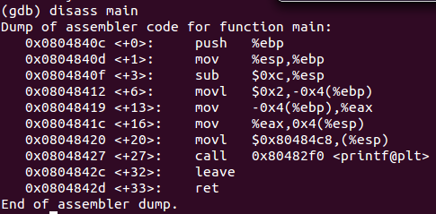
Stack Layout – Before printf
void main(int argc, char** argv)
{
int i = 2;
printf(“%d”, i);
}
EBP - Old
EBP
2
EBP-4
2
ESP+4
0x80484c8
ESP
%d

Slide 13
Behavior of printf
EBP - Old
Parses the format string argument
For each “%d”, traverses the stack upwards
Prints the value stored on the stack
Go to Step 2 until no more %d left
EBP
2
EBP-4
2
ESP+4
0x80484c8
(%d)
ESP

Slide 14
Some Format Parameters
parameter | output | passed as
%d | decimal (int) | value
%u | unsigned decimal (unsigned int) | value
%x | hexadecimal (unsigned int) | value
%s | string ((const) (unsigned) char *) | reference
%n | number of bytes written so far, (* int) | reference
\ is used an escape character – not part of the format parameter
printf ("The magic number is: \x25d\n", 23);
\x25 will be replaced by % during compile time

Slide 15
Format string vulnerabilities?
Exploit how format strings are processed
Typical exploits
Read data off the stack
Crash the program
Write data into arbitrary memory locations
Run shellcode

Slide 16
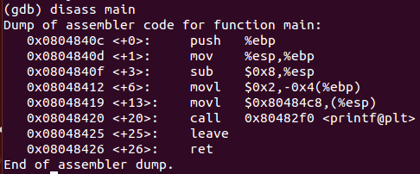
Misusing Format String
void main(int argc, char** argv)
{
int i = 2;
printf(“%d”);
}
EBP - Old
EBP
2
EBP-4
0x80484c8
ESP

Slide 17
If the format string is %d
it displays the value of the local variable
EBP - Old
EBP
2
EBP-4
%d
ESP

Slide 18
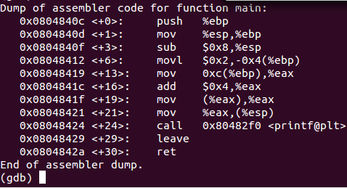
Format String – User input Attack
void main(int argc, char** argv)
{
int i = 2;
printf(argv[1]);
}
EBP - Old
EBP
2
EBP-4
Argv[1]
ESP

Slide 19
Format String – User input Attack
What if argv[1] = %d?
it displays the value of the local variable
EBP - Old
EBP
2
EBP-4
%d
ESP

Slide 20
Format String – User Input with %s
void main(int argc, char** argv)
{
char* userPassword = “This is a user password\n”;
char* adminPassword = “This is an admin password\n”;
printf(argv[1]);
}
./main “%s”
This is a user password

Slide 21
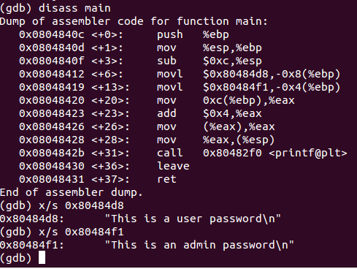
If the user input is %s
EBP - Old
EBP
0x80484f1
EBP-4
0x80484d8
EBP-8
%s
ESP
Prints out the user password!

Slide 22
Printing the stack content
To print an integer in hex printf needs “%x”
Let us pass %x from command line
./main %x
Output: 80484d8
./main 0x%08x
Output: 0x080484d8

Slide 23
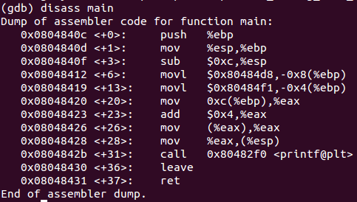
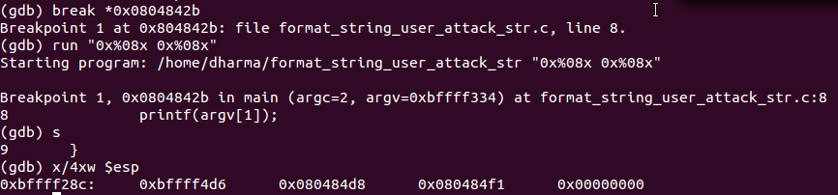
Printing the stack content

Slide 24
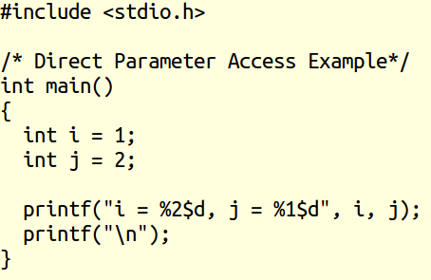

Direct Parameter Access Example
%2$ - 2nd argument
%1$ - 1st argument

Slide 25
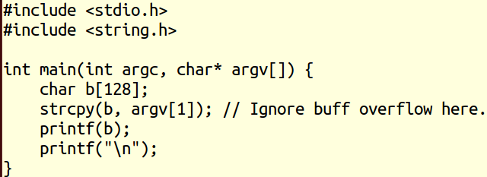
Direct Parameter Access

Slide 26
Direct Parameter Access

Slide 27
Direct Parameter Access
Note: 41414141 = AAAA
5th item corresponds to our input str
Direct access to the 5th item

Slide 28
Crashing the program
Denial of service!
We tried to access 5th item on the stack as a string
Why did the program crash?

Slide 29
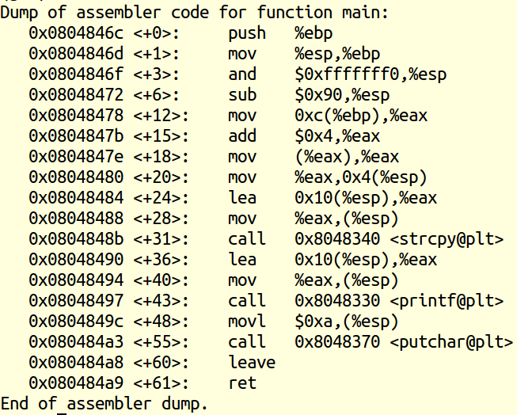

Why the program crashed?
Set a breakpoint before printf

Slide 30
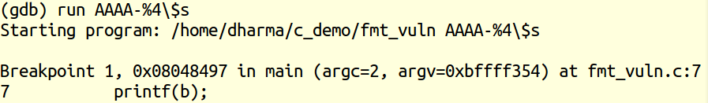
Stack layout before the printf call
Ptr to format string
5th item on the stack is NOT a string pointer
Not a valid address – cause for the crash (see next slides)

Slide 31
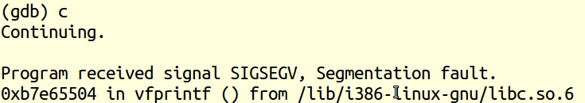


After the print call
(%edi) will not work because 0x41414141 not an address

Slide 32
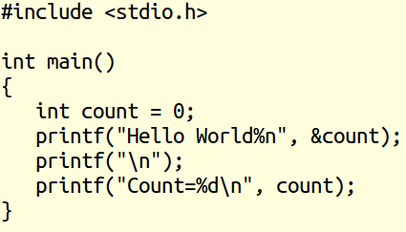

%n option - example
11 bytes in Hello World
%n counts the number of characters printed so far
Need to pass an address as the matching argument

Slide 33
Writing using direct parameter access

Slide 34
Writing using direct parameter access
Denial of service!
We tried to write onto 5th item on the stack (%n)
Why did the program crash?

Slide 35
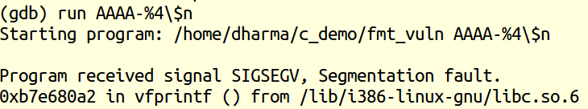
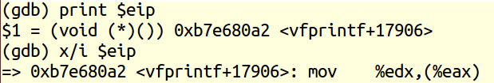


Writing using direct parameter access
Edx = 5 because we printed “AAAA-”
(%eax) will not work because 0x41414141 not an address

Slide 36
Writing using direct parameter access
We control how many characters to write
We also control which memory location to write!
Key for advanced exploits
Injecting shellcode using format string exploits
Corrupt the Global Offset Table?

Slide 37
Global Offset Table (GOT)?
GOT redirects position independent address calculations to an absolute location
located in the .got section of an ELF executable or shared object
Stores the final (absolute) location of a function calls symbol,
used in dynamically linked code

Slide 38
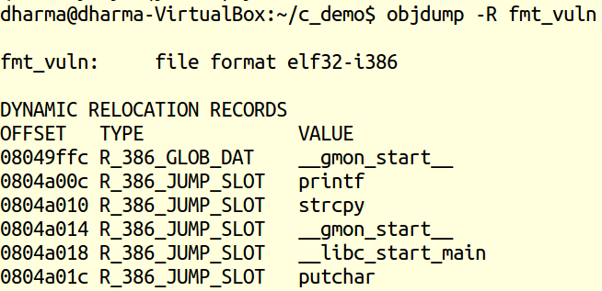
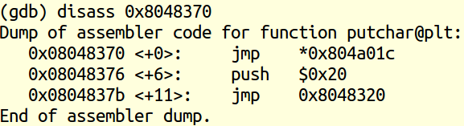
Display GOT using objdump?
We want to modify the address
pointed by 0804a01c

Slide 39
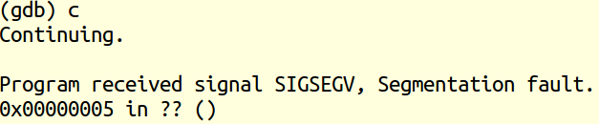
Attacking the GOT?
Stack layout before the print call
Format string

Slide 40


Attacking the GOT?
5 bytes are in our format string
\x08 (byte 1)
\x04 (byte 2)
\xa0 (byte 3)
\x1c (byte 4)
- (byte 5)
Program crashed because putchar’s address is corrupted

Slide 41
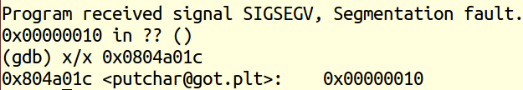
Attacking the GOT?
We wrote 16 bytes into the pointer referenced by the putchar offset

Slide 42
Preparing a shellcode (/bin/sh)
24 bytes of shell code – same used in the last lecture

Slide 43
Inject the shellcode into environment
Some NOPS followed by the shellcode
64 NOPS but you can choose different size

Slide 44
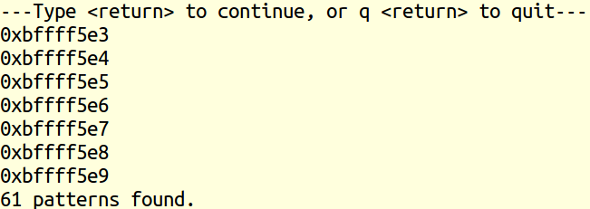

Where is our NOP instruction?

Slide 45
Revisit our goal
Goal: We want to put the address of the NOP in 0804a01c
NOP is stored in 0xbffff5e9
putchar will be tricked – we will run our shellcode instead!

Slide 46

Challenge
0xbffff5e9 is a very big number for %u option
We usually cannot write large number of bytes in one step
Good news: We can write in two steps
Step 1: f5e9 into address pointed by 0804a10c
Step 2: bfff into address pointed by 0804a10e
e because we want to start from the 3rd byte onwards

Slide 47

Writing two least significant bytes
62953 bytes should be written
Same as in the GOT

Slide 48

After printf execution
GOT table corrupted (partial writing of NOP address)

Slide 49
Writing two most significant bytes
Step 1: f5e9 into address pointed by 0804a10c
Step 2: bfff into address pointed by 0804a10e

Slide 50
Writing two most significant bytes
Why f5ea?

Slide 51


How many bytes to write to 5th item?

Slide 52
Updating the GOT to shellcode
Stack layout before print
You may also try trial-and-error to calculate %<n>u

Slide 53
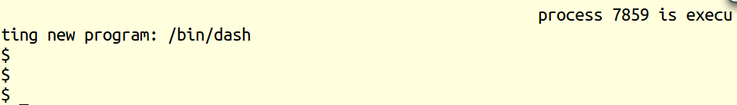
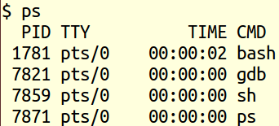
We got a shell☺
Our new shell

Slide 54
Replicate on your machine?
ASLR settings
Inside gdb default is not turned on (no problem)
Outside gdb requires ASLR turned off
Execstack should also be enabled
gcc –z execstack
Otherwise, we cannot run our shellcode
placed onto the stack (recall our find $esp, etc.)
Assumption: format string is on the stack
Count the number of pops (%x) to hit the format string

Slide 55
Format String Vulnerabilities - Summary
Happen when the user input is directly substituted for args to the printf function
Also happen when the number of parameters is less than the number of %d (or %s, etc.)
Hacker can
Obtain the stack content
Crash the program by passing “too many” %s, etc.
Run shellcode
All functions in the family of printf are vulnerable to format string inputs!

